Slide 1
Background Check Instructions

Slide 2
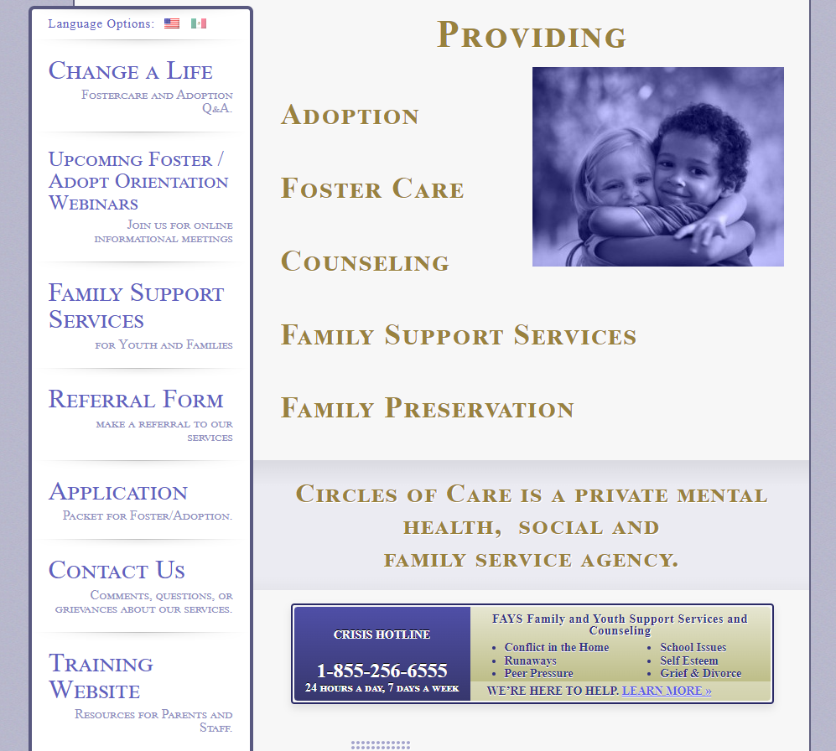
Background checks are required for all foster to adopt parents, household members who are 14 years of age and older, frequent visitors, babysitters, and respite care providers.
To complete a consent to have Circles of Care run a background check go to our website:
www.circlesofcareinc.org and click on Application to the left of the home screen.

Slide 3
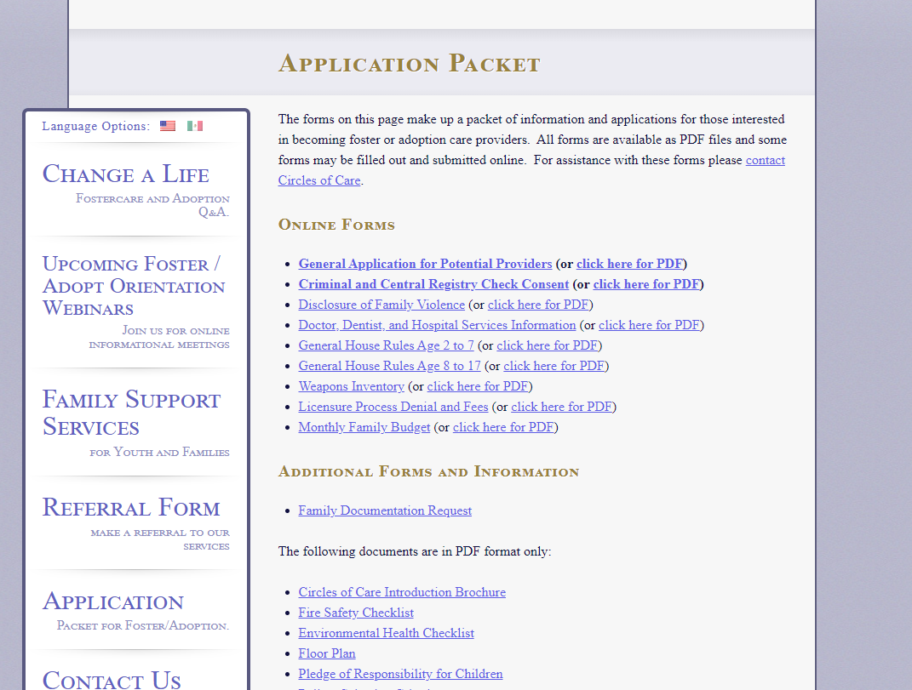
There will be a list of forms to complete.
Click on Criminal and Central Registry Check Consent. Once you complete the form it will automatically email it to the Family Home Developer. Since the form is completed online it will not allow us to access your social security number. You will need to submit a copy of your social security card and drivers license to your local Family Home Developer or through a secure link to our DropBox feature which will be provided to you. We cannot run your background without them.

Slide 4
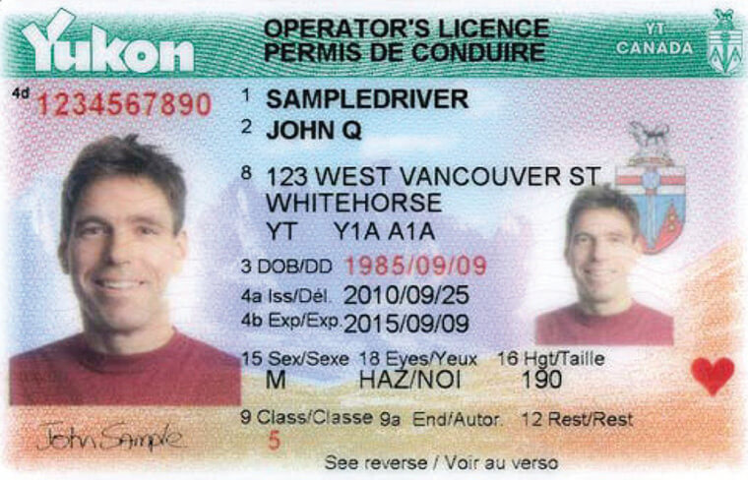
Complete the background consent in its entirety. Include current name, past names, maiden name, address, phone number, email address, driver’s license number and state issued, past cities you have lived in the State of Texas, and other states you lived in within the past 5 years. Also include any past arrests or criminal history.
Note: adults cannot share an email address. Email addresses must be individualized. Minors can use a parent’s email address.
Also be sure that the name being ran for the background check matches what is on your driver’s license.
This Photo by Unknown Author is licensed under CC BY-SA

Slide 5
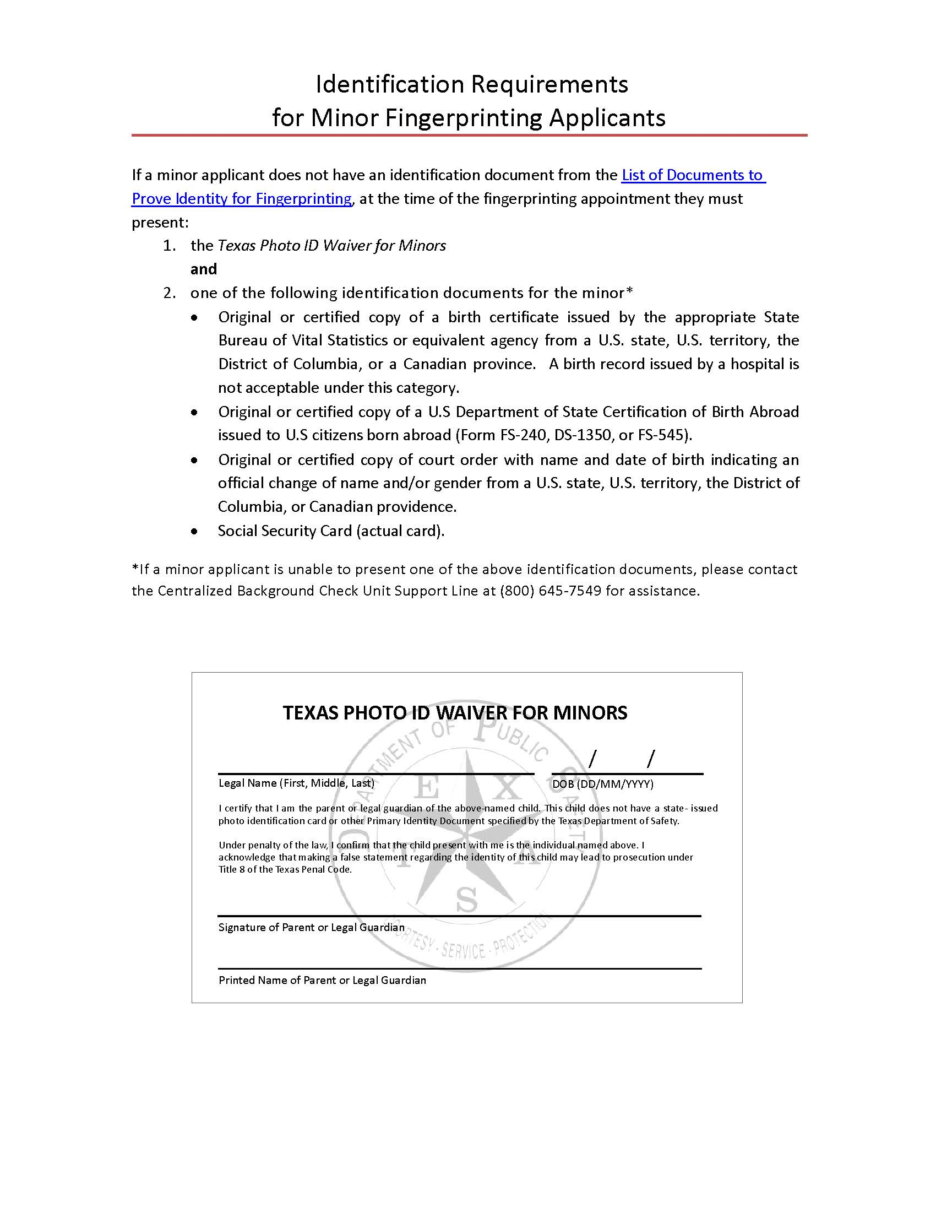
Minors who do not have an identification card will need to ensure that this completed form is taken when completing the FBI Fingerprinting. This form can be found at https://www.dfps.texas.gov/Background_Checks/documents/ID_Requirements_Waiver_Minor_Fingerprint_Applicants.pdf

Slide 6
Once the form is complete, the background will be run by a Circles of Care staff member or Family Home Developer. You should receive an email from the State of Texas letting you know if you need to be fingerprinted or if you are Eligible. Eligible means you have a valid fingerprint already on file. A letter will be attached to the email letting you know what you need to do next. The email subject will read:
Childcare Regulation Background Check for Circles of Care: Actions You Must Complete
This is the email address that the email will be coming from: classNotifications@hhsc.state.tx.us
The email may go to your Spam or Junk folder so please check for it there.
You have 30 days to schedule your fingerprints after the date Circles of Care runs it.
**The cost of the FBI is $38.54 and is reimbursed by Circles of Care for Potential Parents, Household Members under the age of 18 and Respite Providers.

Slide 7
Example of Email for Scheduling FBI Fingerprints

Slide 8
Example of Email if Out of State Central Registry is required

Slide 9
If you have a history of being validated for Abuse and or Neglect of a child anywhere in the US, Circles of Care will not receive the results of your background check. You will more than likely receive a phone call or letter from the State of Texas informing you that you have history and to notify Circles of Care. This is important because without this information, Circles of Care would be unaware or any abuse/neglect history and unable to move forward with your application
Once fingerprints have been completed you will receive an email within a few days letting you know you are Eligible. If you have any criminal history this will be sent as a Match Letter. You can still be Eligible with criminal history, but Circles of Care has the right to deny you licensure dependent on the nature of the criminal history, number of arrests, and outcomes. Keep in mind that if you are eligible for a Risk Assessment, Circles of Care does not do these for new foster to adopt families. A Risk Assessment means that we are confident you will not be a risk to children in care and as we do not know you, we are not willing to take this risk.

Slide 10
